Slide 1
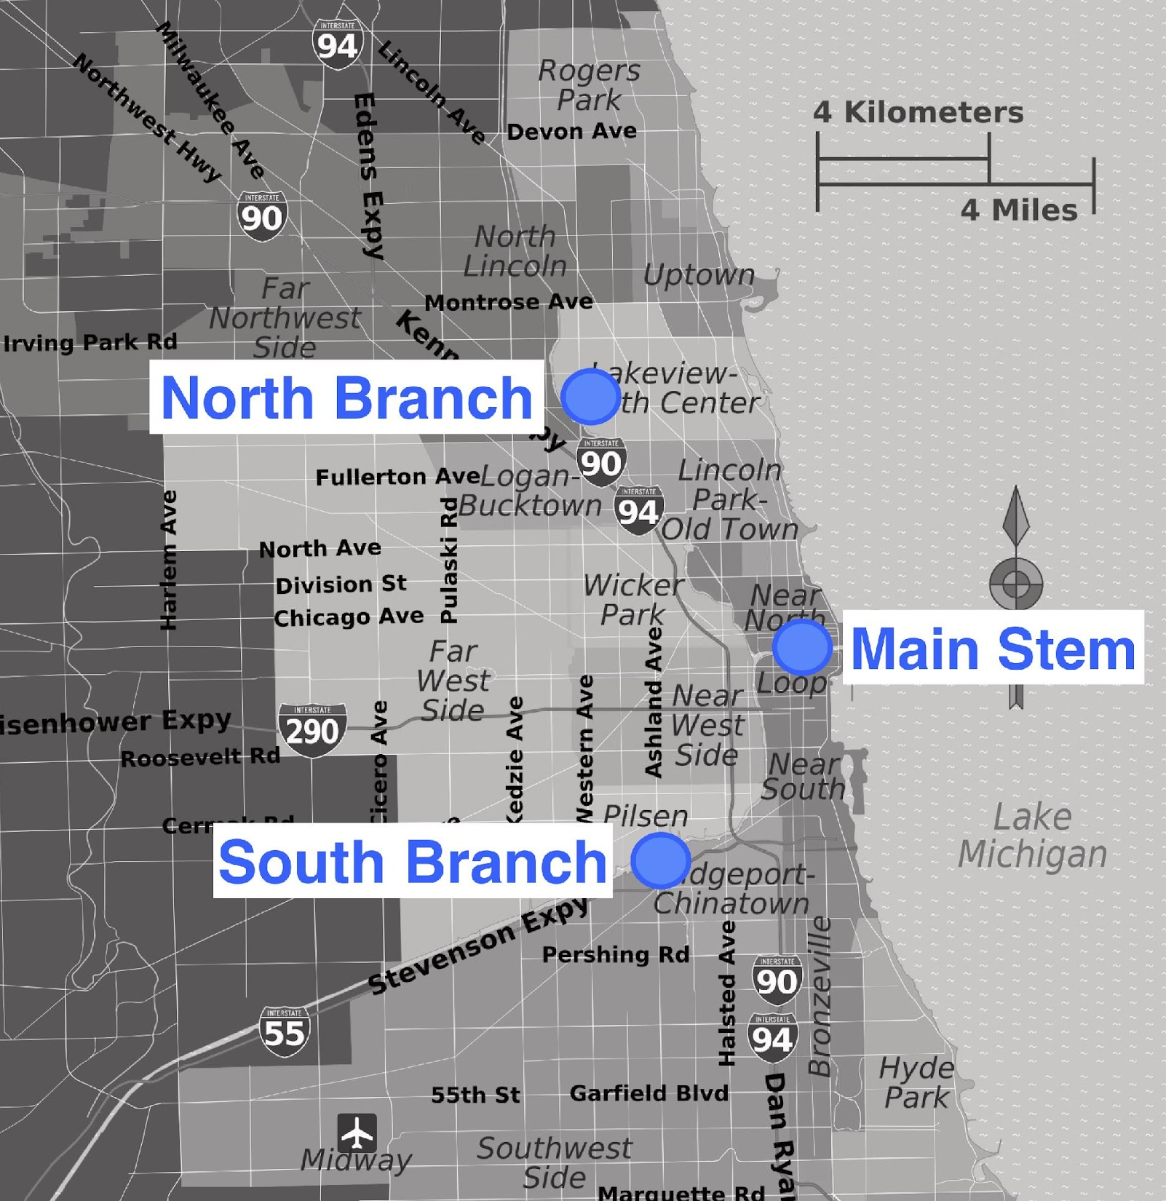
Chicago River
Click on each branch of the Chicago River to learn more!
Watch a video about the three branches here
Learn about the history of the Chicago River here

Slide 2
Return to the map!

Slide 3
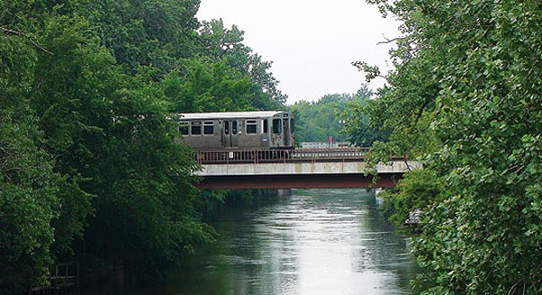
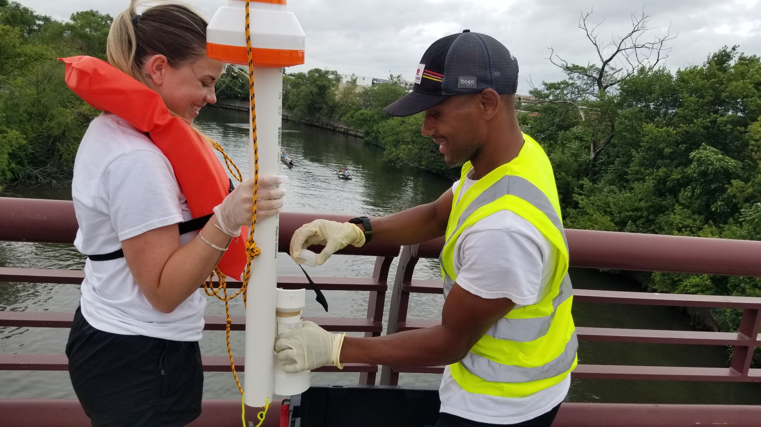
North Branch Facts
Length: 30 miles (begins in Lake County)
Width: 90 to 300 feet
Average depth: 10-15 feet
Uses: Recreation (kayaking, boating), occasional barge traffic
Adjacent land: Mix of commercial, industrial, parks, and residential uses
H2NOW probe location: Near Fullerton Ave bridge
Image: Chicago Reader
Return to the map!
Notes:
Image source top: https://www.chicagoreader.com/chicago/lincoln-square-north-center-ravenswood-neighborhood-guide/Content?oid=1486950
Image source bottom: Miranda Kerr Consulting LLC of H2Now sampling site

Slide 4
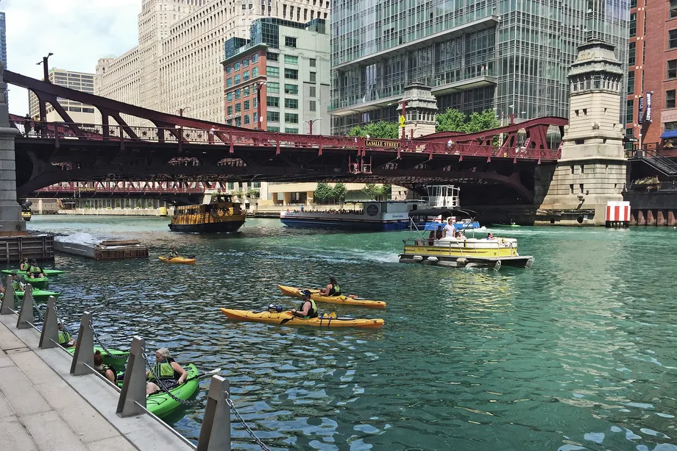
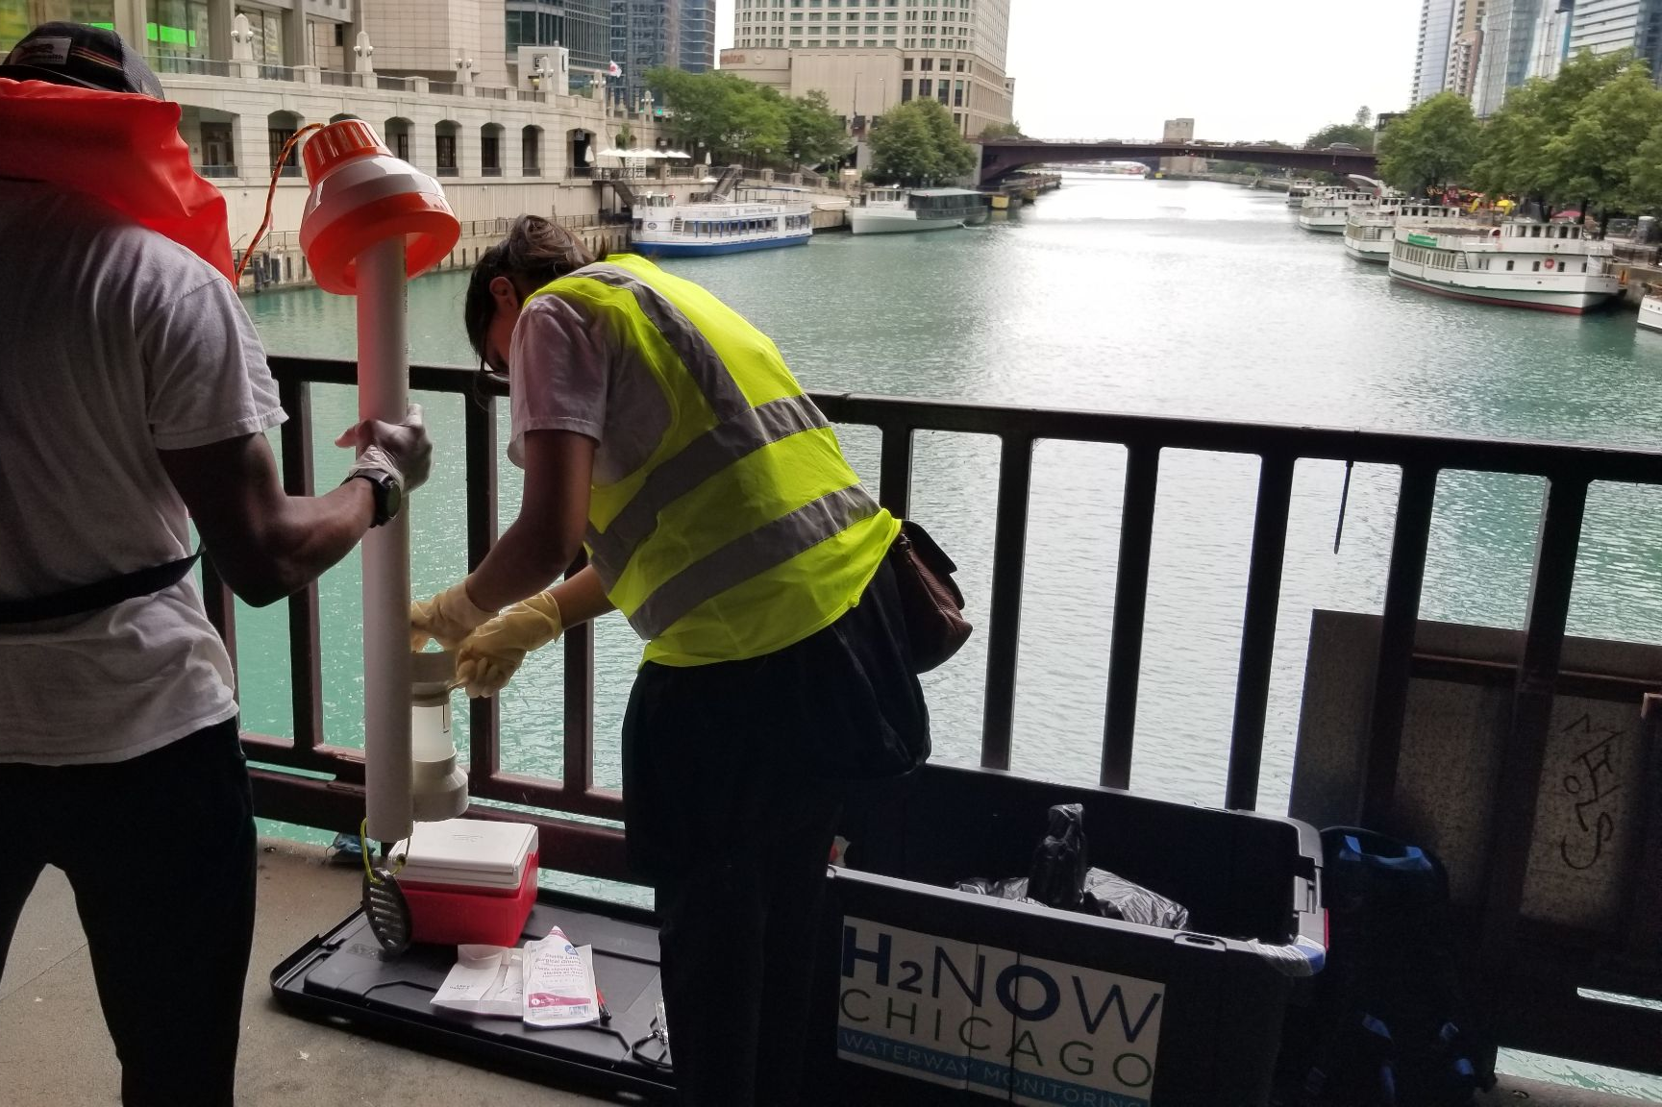
Main Stem
Image:Chicago Sun Times
Length: 1.5 miles
Width: 200-260 feet
Depth: 18 feet
Most of the border is tall, concrete walls
Uses: large tourist boats, commercial and industrial transportation vessels, for recreational activities (kayaking, boating, fishing), and commuter transportation (water taxis)
Adjacent land: Businesses (bars, restaurants, cafes), residential buildings (mostly apartments and hotels), and designated tourist areas
H2NOW probe location: West of the Michigan Ave (DuSable) bridge
Return to the map!
Notes:
Image source top: https://chicago.suntimes.com/2019/7/16/18761168/chicago-river-open-water-swim-doug-mcconnell
Image source bottom: Miranda Kerr Consulting LLC of H2Now sampling site

Slide 5
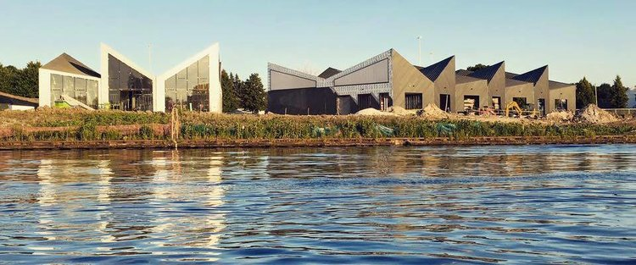
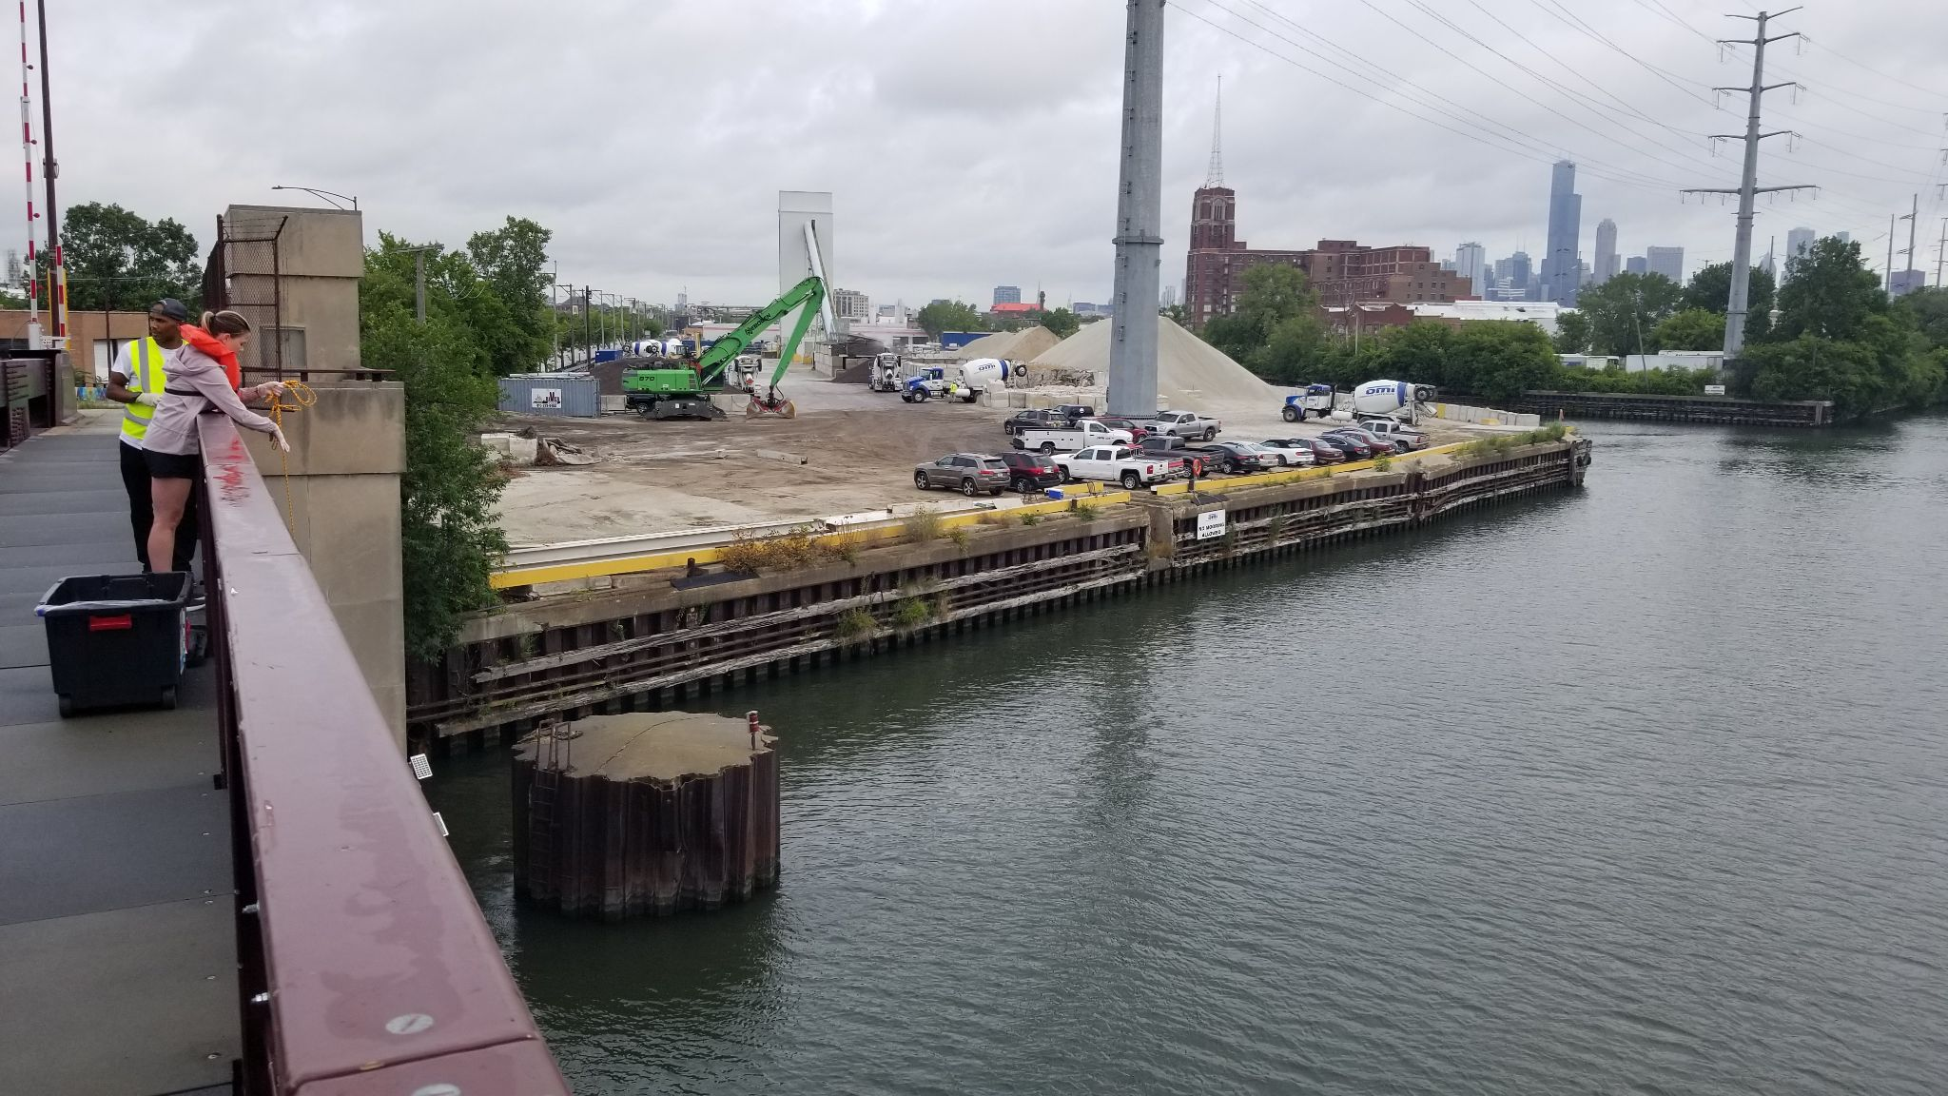
South Branch
Eleanor
Boathouse,
Chicago Parks Foundation
Length: 4.5 miles
Width: 200-250 feet
Depth: 15-20 feet
Borders of the river are vertical dock walls composed of rock materials and sediment
Uses: Commercial and industrial transportation
Eleanor Boathouse is one of few designated parks with canoeing, kayaking, and fishing
Adjacent land: Industrial and commercial
H2NOW probe location: Loomis St bridge
Return to the map!
Notes:
Image source top: https://www.chicagoparksfoundation.org/seeinggreen/2017/9/26/increasing-access-to-the-chicago-river-the-eleanor-street-boathouse-in-bridgeport
Image source bottom: Miranda Kerr Consulting LLC of H2Now sampling site

Slide 6
History of the Chicago River
1848 marked the completion of the 96-mile Illinois and Michigan (I&M) Canal, which joined the Chicago and Illinois Rivers, providing a direct connection between the Great Lakes and the Mississippi River
Chicago’s population grew from 29,963 to 1,099,850 between 1850 and 1890 – more than 36 times!
Water quality deteriorated as industries discharged waste (stockyards, steel mills, lumber yards, and glue, soap, and leather plants)
Human waste also posed a risk to health, as Lake Michigan was the source of drinking water.
A major project to reverse the flow of the river and, thereby, re-direct the city’s sewage was initiated in 1892.
By 1900, the 28-mile long CSSC replaced the I&M Canal, followed by a series of locks built to control the direction of the flow.
Image source: USGS
https://pubs.usgs.gov/fs/FS-014-99/index.html
Video “How Chicago Reversed its River”
Return to the map!

Slide 7
How Chicago Reversed Its River
Return to the map!

